Slide 1
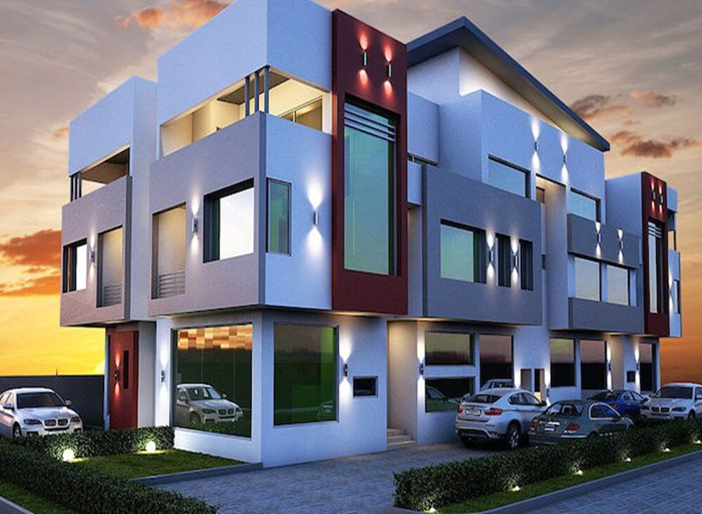

ANALYSIS OF FACTORS AFFECTING PROPERTY CHOICE BEHAVIOUR BY RESIDENTs IN LAGOS STATE (NIGERIA)

Slide 2
GROUP MEMBERS
EMEKA OBINNA CHIMA
CHINEDU EVARISTUS
OLUWASEUN AWONUGA

Slide 3
Background / INTRODUCTION
Lagos state (Nigeria) is the most populous city in Nigeria inhabiting 10% of Nigeria’s total population of 200M
Lagos has the smallest landmass in Nigeria, but it is the most active commercial centere and property market
The demand for housing in Lagos State alone is estimated at 3.17 million
Residents are in search of exclusive ownership of homes and to enjoy the comfort of basic utility services such as water, electricity and security
Real estate developers have dominated the property market to build various property types for sale
About 87% of the properties bought by consumers were duplex.
This project aims to evaluate main factors affecting consumer choice of purchasing duplex properties. It shall also provide impacts, recommendations and business opportunities

Slide 4

Why this research study
Housing demand and infrastructural congestion is a peculiar challenge confronting developing economies especially Lagos state.
Motivation
Property choice behaviour and household considerations in purchasing property types has not been explored from the perspective of consumers in African continent and Nigeria in particular.

Slide 5


METHODOLOGY
1
ANALYSIS OF PROPERTY PRICES
Distribution of property prices will be graphically represented by Histogram.
Range of property prices in columns will be set to N100M interval
Intervals will be transformed into a price category group to facilitate comparison among property prices and number of houses sold per category
Exploratory analysis will be carried out on each price category to extract insights on the number of property types sold.
Discover any Frequent pattern or trend in property types sold per category
2
Analysis in property CHOICE BEHAVIOR BY PRICE CATEGORY

Slide 6
METHODOLOGY
3
ANALYSIS OF FACTORS INFLUENCING PROPERTY CHOICE
Frequency analysis is performed on property characteristics (bedrooms, bathrooms, toilet and parking spaces) identifying which characteristics have a concentration in affecting property choice
Analysis is performed to identifying locations and regions where residents have a higher concentration of consumers purchasing a property
4
LOCATION DISTRIBUTION OF PROPERTY SALE

Slide 7
ANALYSIS OF PROPERTY PRICES
Category Name | Property Price Range
PC 1 | N90K - N99M
PC 2 | N100M - N199M
PC 3 | N200 - N299M
PC 4 | N300M - N399M
PC 5 | N400M - N499M
PC 6 | >= N500M
Total of 18445 properties were sold in Lagos state
80% of the properties bought by the consumers were properties within price category 1 & 2

Slide 8
Analysis in property CHOICE BEHAVIOR
Detached duplex property had the highest concentration in property choice behavior across all price ranges
All duplex types (detached, semi-detached & terraces) were frequent property choices in each price category

Slide 9
ANALYSIS OF FACTORS INFLUENCING PROPERTY CHOICE
Parking space was the most dominant factor influencing residents to purchase a duplex property. A probable reason for this cause might the absence of adequate parking space in their previous residence.
Bedroom size and number of toilets also contributed to an extent in influencing residents to purchase a duplex house

Slide 10
PROPERTIES SOLD ACROSS LOCATIONS IN LAGOS
Location | Properties sold
Lekki | 10841
Ajah | 2142
Ikoyi | 1541
Ikeja | 686
Victoria Island (VI) | 493
Ibeju Lekki | 492
Magodo | 375
Ikorodu | 236
Isheri North | 194
Isolo | 176
Alimosho | 142
Agege | 123
Surulere | 122
Ojodu | 91
Yaba | 86
Ipaja | 85
Ifako-Ijaiye | 82
Ikotun | 75
Location | Properties sold
Maryland | 65
Gbagada | 55
Ogudu | 43
Amuwo Odofin | 42
Ojo | 35
Epe | 33
Ilupeju | 31
Ayobo | 22
Shomolu | 17
Ketu | 17
Isheri | 16
Ejigbo | 12
Oshodi | 11
Apapa | 11
Badagry | 9
Idimu | 9
Lagos Island | 5
Agbara-Igbesa | 5
Location | Properties sold
Ijaiye | 5
Kosofe | 4
Ijede | 3
Mushin | 3
Eko Atlantic City | 2
Imota | 2
Egbe | 1
Oke-Odo | 1
Ojota | 1
Ijesha | 1
Orile | 1

Slide 11
LOCATION DISTRIBUTION ANALYSIS
18445 properties were sold across 48 locations
The Top 5 locations accounted for 85% (15,703) of the total number of properties sold in Lagos state
43 locations accounted for 15% (2,742) of the total number of properties sold Key Insights.
A probable reason for residents purchasing a duplex property in these 5 locations might be proximity to place of place of work.
Since these locations are major commercial centers, there is also a likelihood that many of the buyers are Business Executives, Entertainers, or diplomats

Slide 12
IMPACTS BY PROPERTY CHOICE BEHAVIOR
Impacts
Infrastructural Congestion caused by excessive land usage for housing development
Traffic Congestion resulting to quicker downgrade of road infrastructure
Noise & Air Pollution leading to poor health due to unclean air

Slide 13
RECOMMENDATIONS / POLICIES
Recommendations
Policy Making
Developers should consider construction of multi-level low-cost houses for with the option of outright purchase of apartment. This initiative has the potential to limit excess land usage faced by housing developers.
Policies should be created to make Industries and Businesses with high concentration of commercial activities in choice property location open new outlets in other locations in the state
Policies on building plans should be reviewed to ensure developers make provision for facilities such as parking space during construction

Slide 14
BUSINESS OPPORTUNITIES
BUSINESS
OPPORTUNITIES
Food delivery service
Driving school service
Automobile Services
Car hire services

Slide 15


Thank you!

